Slide 1
Circuit Switching and Packet Switching

Slide 2
Overview
Networks are used to interconnect many devices.
We have checked with Local Area Networks.
Now, wide area networks
Since the invention of the telephone, circuit switching has been the dominant technology for voice communications.
Since 1970, packet switching has evolved substantially for digital data communications. It was designed to provide a more efficient facility than circuit switching for bursty data traffic.
Two types of packet switching:
Datagram (such as today’s Internet)
Virtual circuit (such as Frame Relay, ATM)

Slide 3
Switched Communications Networks
Long distance transmission between stations (called “end devices”) is typically done over a network of switching nodes.
Switching nodes do not concern with content of data. Their purpose is to provide a switching facility that will move the data from node to node until they reach their destination (the end device).
A collection of nodes and connections forms a communications network.
In a switched communications network, data entering the network from a station are routed to the destination by being switched from node to node.

Slide 4
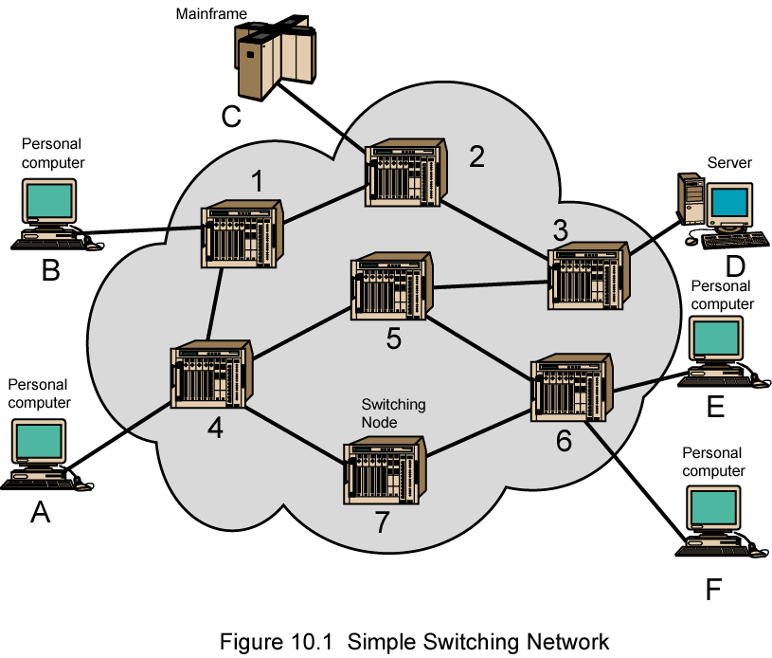
Simple Switching Network

Slide 5
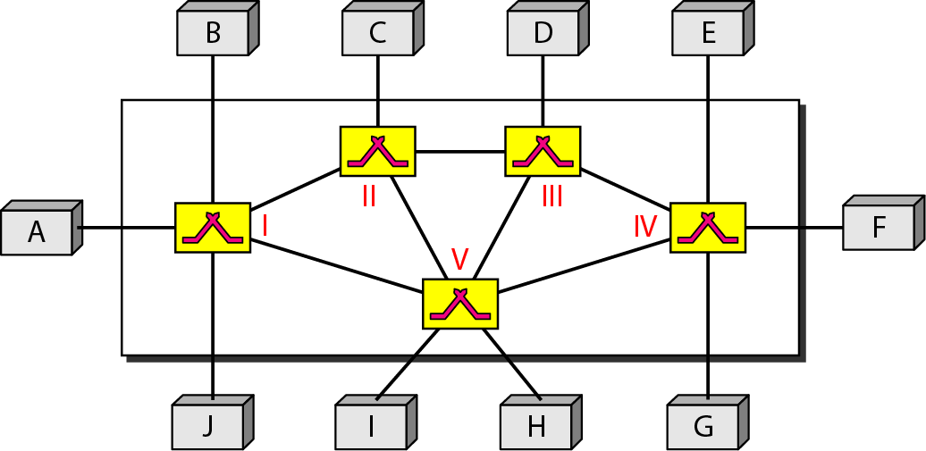
Figure: Switched network

Slide 6
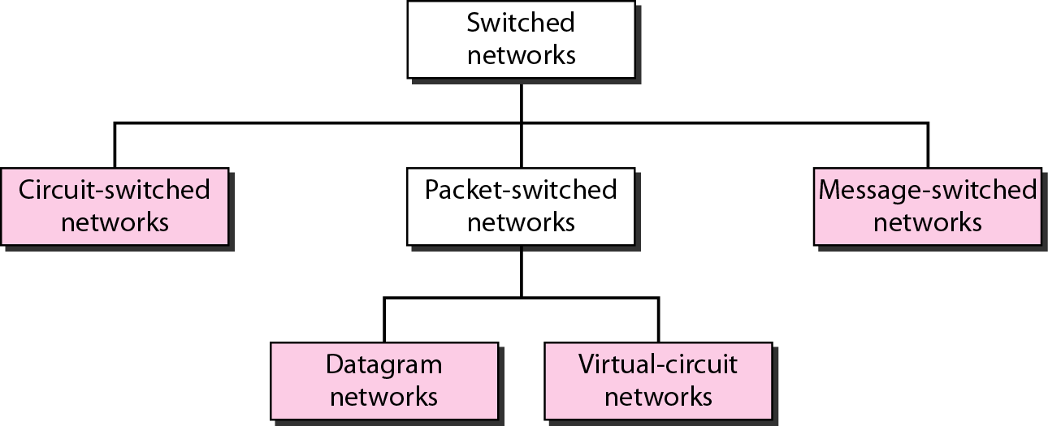
Taxonomy of switched networks

Slide 7
Switching Nodes
Nodes may connect to other nodes, or to some stations.
Network is usually partially connected
However, some redundant connections are desirable for reliability
Two different switching technologies
Circuit switching
Packet switching

Slide 8
Circuit switching
Circuit switching is a technique that directly connects the sender and the receiver in an unbroken path.
Telephone switching equipment, for example, establishes a path that connects the caller's telephone to the receiver's telephone by making a physical connection.
With this type of switching technique, once a connection is established, a dedicated path exists between both ends until the connection is terminated.
Routing decisions must be made when the circuit is first established, but there are no decisions made after that time

Slide 9
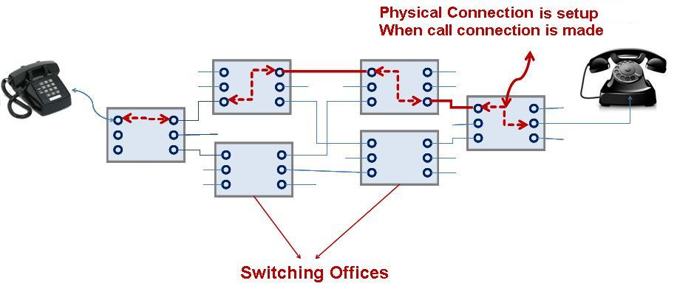
Circuit Switching

Slide 10
Circuit Switching
Circuit switching:
There is a dedicated communication path between two stations (end-to-end)
The path is a connected sequence of links between network nodes. On each physical link, a logical channel is dedicated to the connection.
Communication via circuit switching has three phases:
Circuit establishment (link by link)
Routing & resource allocation (FDM or TDM)
Data transfer
Circuit disconnect
Deallocate the dedicated resources

Slide 11
The switches must know how to find the route to the destination and how to allocate bandwidth (channel) to establish a connection.
A circuit-switched network is made of a set of switches connected by physical links, in which each link is divided into n channels.
In circuit switching, the resources need to be reserved during the setup phase; the resources remain dedicated for the entire duration of data transfer until the teardown phase.

Slide 12
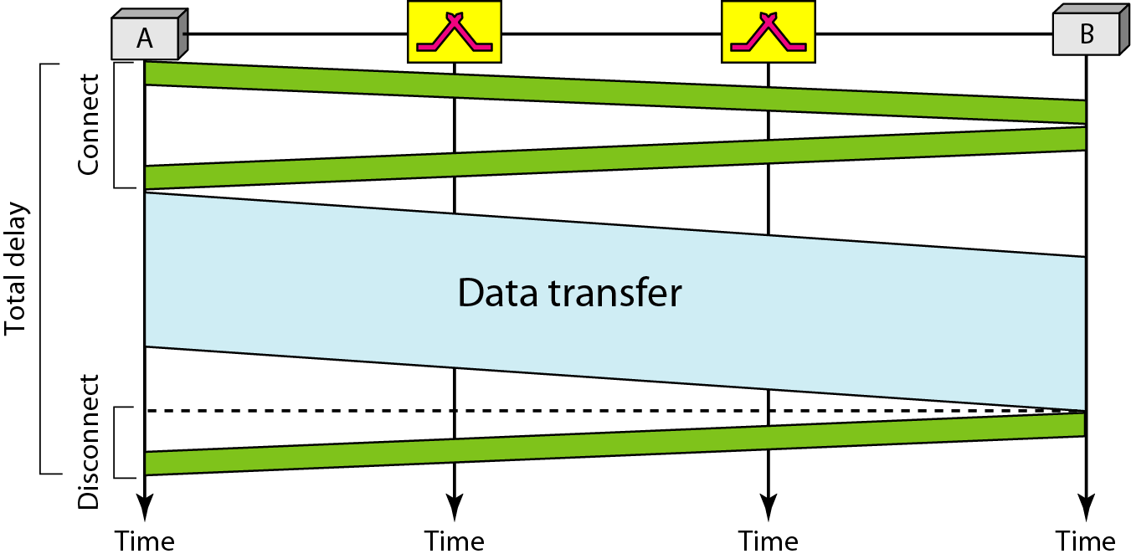
Figure :Delay in a circuit-switched network

Slide 13
Circuit Switching Properties
Inefficiency
Channel capacity is dedicated for the whole duration of a connection
If no data, capacity is wasted
Delay
Long initial delay: circuit establishment takes time
Low data delay: after the circuit establishment, information is transmitted at a fixed data rate with no delay other than the propagation delay. The delay at each node is negligible.
Developed for voice traffic (public telephone network) but can also applied to data traffic.
For voice connections, the resulting circuit will enjoy a high percentage of utilization because most of the time one party or the other is talking.
But how about data connections?

Slide 14
Circuit Switching: Advantage
Circuit is dedicated to the call
– no interference, no sharing
Guaranteed the full bandwidth for the duration of the call
Guaranteed quality of service

Slide 15
Circuit Switching: disadvantage
Inefficient
●Channel capacity dedicated for duration of connection
●If no data, capacity wasted
Set up (connection) takes time
It was primarily developed for voice traffic rather than data traffic

Slide 16
Packet Switching Principles
Problem of circuit switching
designed for voice service
Resources dedicated to a particular call
For data transmission, much of the time the connection is idle (say, web browsing)
Data rate is fixed
Both ends must operate at the same rate during the entire period of connection
Packet switching is designed to address these problems.

Slide 17
Basic Operation
Data are transmitted in short packets
Typically at the order of 1000 bytes
Longer messages are split into series of packets
Each packet contains a portion of user data plus some control info
Control info contains at least
Routing (addressing) info, so as to be routed to the intended destination
Recall the content of an IP header!
store and forward
On each switching node, packets are received, stored briefly (buffered) and passed on to the next node.

Slide 18
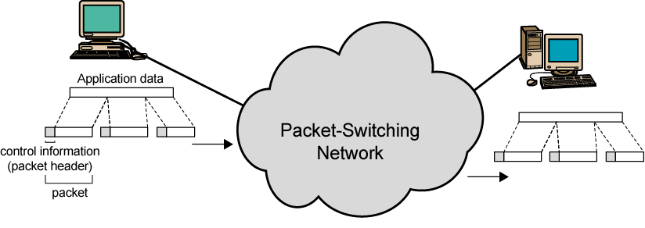
Use of Packets

Slide 19
Advantages of Packet Switching
Line efficiency
Single node-to-node link can be dynamically shared by many packets over time
Packets are queued up and transmitted as fast as possible
Data rate conversion
Each station connects to the local node at its own speed
In circuit-switching, a connection could be blocked if there lacks free resources. On a packet-switching network, even with heavy traffic, packets are still accepted, by delivery delay increases.
Priorities can be used
On each node, packets with higher priority can be forwarded first. They will experience less delay than lower-priority packets.

Slide 20
Packet Switching Technique
A station breaks long message into packets
Packets are sent out to the network sequentially, one at a time
How will the network handle this stream of packets as it attempts to route them through the network and deliver them to the intended destination?
Two approaches
Datagram approach
Virtual circuit approach

Slide 21
Datagram
Each packet is treated independently, with no reference to packets that have gone before.
Each node chooses the next node on a packet’s path.
Packets can take any possible route.
Packets may arrive at the receiver out of order.
Packets may go missing.
It is up to the receiver to re-order packets and recover from missing packets.
Example: Internet

Slide 22
Datagram
In a packet-switched network, there is no resource reservation ; resources are allocated on demand.
A switch in a datagram network uses a routing table that is based on the destination address.
The destination address in the header of a packet in a datagram network remains the same during the entire journey of the packet.
Switching in the Internet is done by using the datagram approach to packet switching at the network layer.

Slide 23
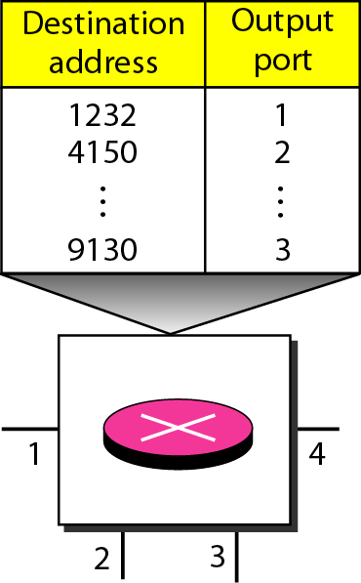
Figure Routing table in a datagram network

Slide 24
Datagram Approach

Slide 25
Datagram Approach

Slide 26
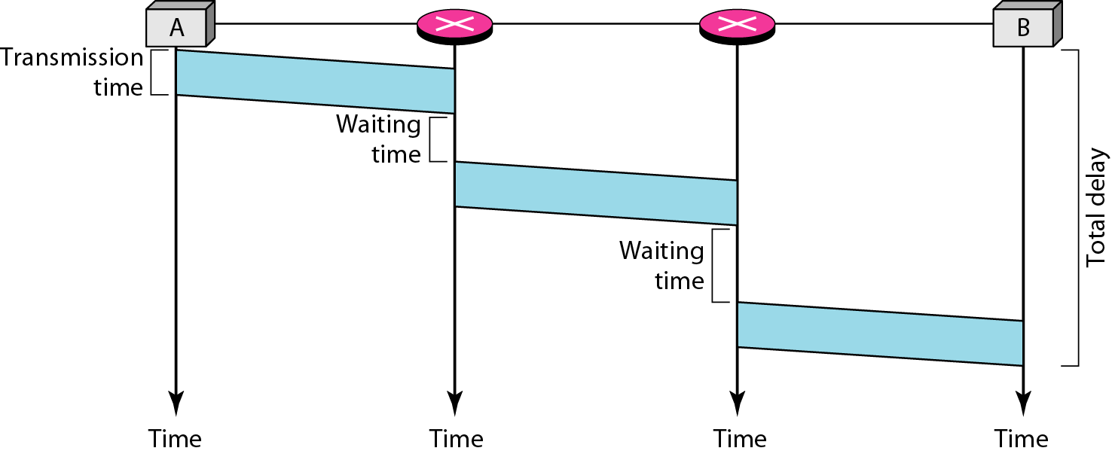
Figure : Delay in a datagram network

Slide 27
Virtual Circuit
A virtual-circuit network is a cross between a circuit-switched network and a datagram network. It has some characteristics of both.
In virtual circuit, a preplanned route is established before any packets are sent, then all packets follow the same route.
Each packet contains a virtual circuit identifier instead of destination address, and each node on the pre-established route knows where to forward such packets.
The node need not make a routing decision for each packet.
Example: X.25, Frame Relay, ATM

Slide 28
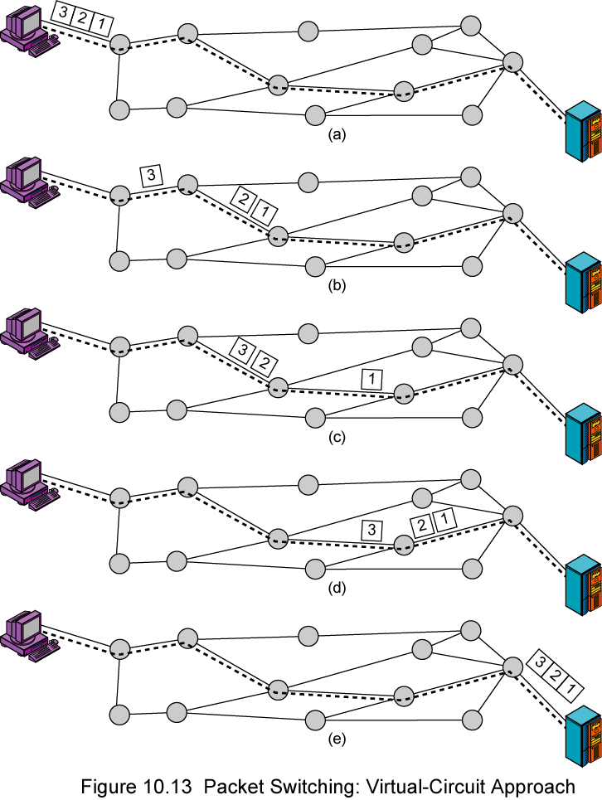
Virtual Circuit
A route between stations is set up prior to data transfer.
All the data packets then follow the same route.
But there is no dedicated resources reserved for the virtual circuit! Packets need to be stored-and-forwarded.

Slide 29
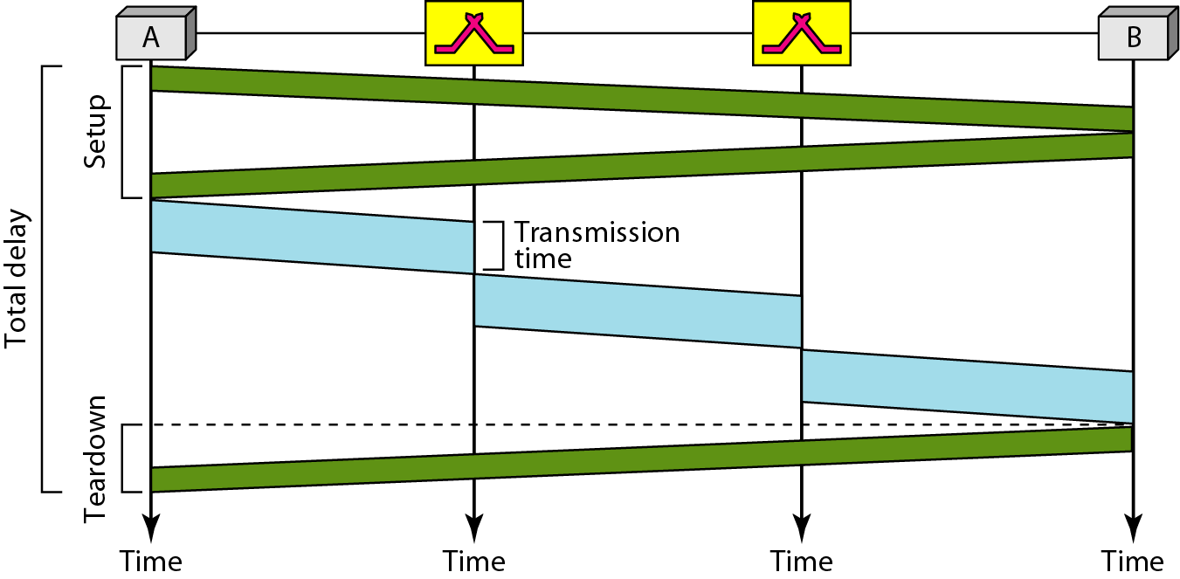
Figure: Delay in a virtual-circuit network

Slide 30
Advantages of Virtual Circuit
All packets follow the same route, so they arrive in the original order.
Routes may be changed on the fly, achieving the best efficiency possible.
If data arrives with error, node request the sender for the retransmission of the packet. Hence the approach is reliable.
Small header size, since packet don't contain destination address.
Less switching delays.

Slide 31
Disadvantages of Virtual Circuit
Requires more Memory and Processing power.
If one of the node doesn't work well, the complete connection is interrupted.
Unequal distribution of load among routers in the network.

Slide 32
Virtual Circuits vs. Datagram
Virtual Circuits Approach
Network can provide sequencing and error control
Packets are forwarded more quickly
No routing decisions to make
Less reliable
Loss of a node looses all circuits through that node
Datagram Approach
No call setup phase
Better if few packets
More flexible
Routing can be used to avoid congested parts of the network
More reliable
If a node fails, subsequent packets may find an alternate route that bypass that node

Slide 33
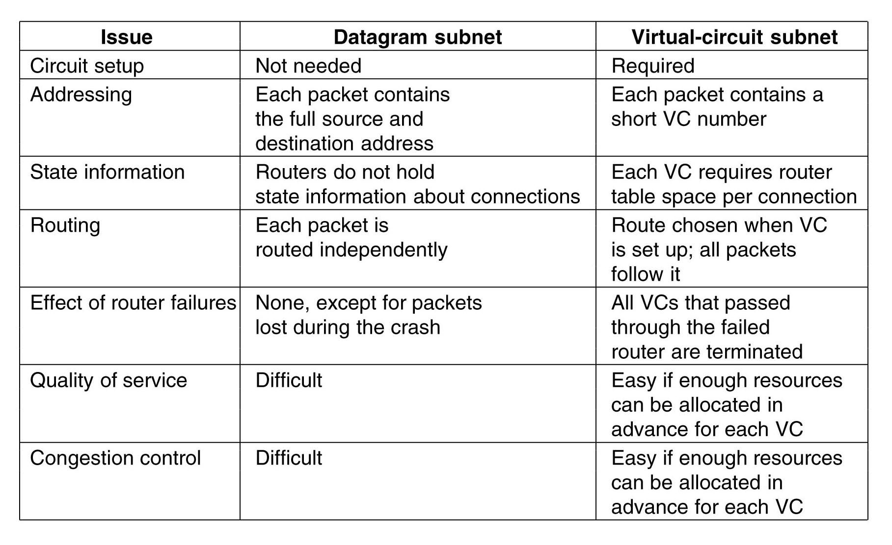
Comparison

Slide 34
Circuit Switching vs. Virtual Circuits
Path
A dedicated path is established between two devices for the duration of session.
Reserved Resources
The link (multiplexed / not multiplexed) that makes the path are dedicated, and cannot be used by other connections
The entire information is to be transmitted at a constant data rate.
Route
No dedicated path is established. Only a route is defined. Each switch creates an entry in its routing table for the duration of virtual circuit
Shared Links
The link that makes a route can be shard by other connections
Each packet follows the same route to reach the destination

Slide 36
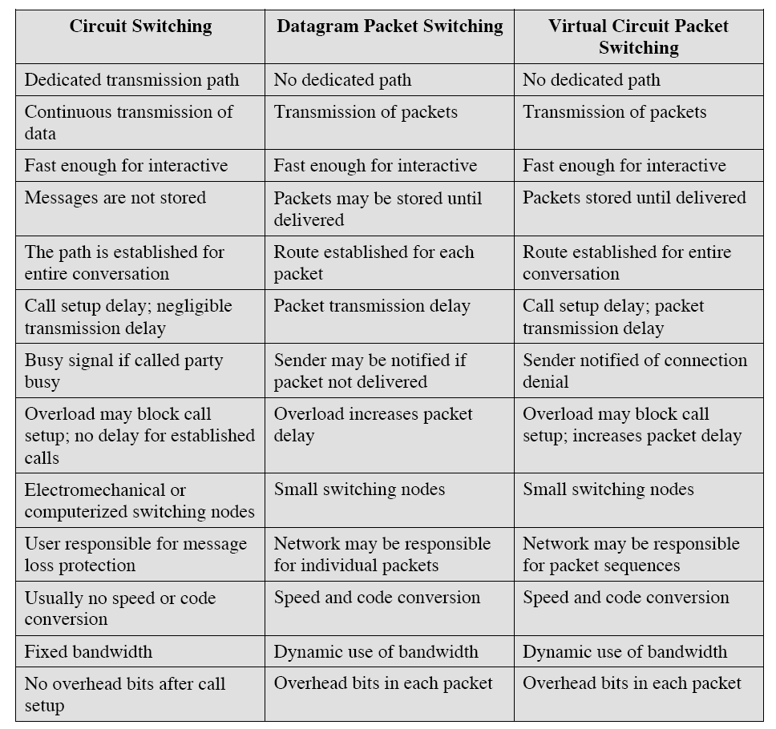
Comparison of communication switching techniques

Slide 37
